Slide 1

React: A JS Library for Building User Interfaces
By Srinivas Lade and Peter Wu

Slide 2
Making User Interfaces
IT’S HARD
Complex and Intricate
Page Manipulation
Notes:
So why do we need a library for creating user interfaces? Whats wrong with the regular stuff like HTML, CSS, and Javascript?
Well basically because for a lot of people,
<Press>
It really does suck. And when I mean a lot of people, I mean both for hobbyistdevelopers or big companies. Managing a large frontend website was a huge struggle for two reason: <list reasons>
Now lets go into these points in detail.

Slide 3
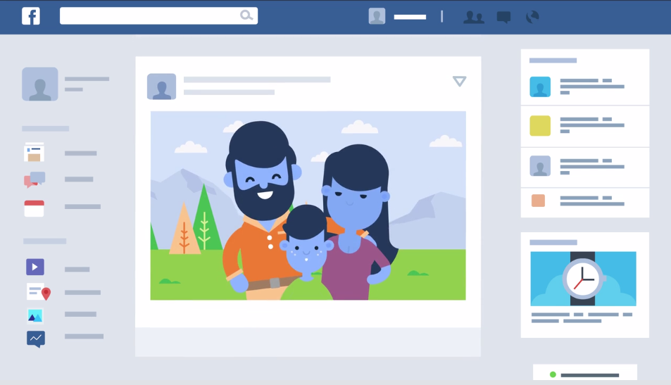
1) Complex and Intricate
Notes:
So why are user interfaces complex and intricate? Lets looks at an example. Take your facebook feed.
Now already we see that there are multiple parts that we can separate. First there is the header navigation bar.
There is the actual posts itself. Then there is the list of friends. There are ads, the groups you are part of, ad so much more.
Furthermore, you need to share information across the page, like how your name shows up in multiple pages.
Sometimes, one part of the page can trigger another part, like clicking on your friend brings up the chat history or clicking on a post redirects you to a new page with the same header.
There are a lot of parts and they interact with each other and can be reused.
Stuff to talk about:
Stuff is made up of smaller stuff
Reusable parts
Triggers between parts
Sharing data

Slide 4
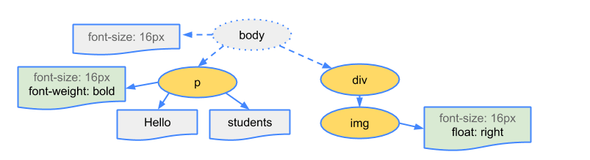
2) Page Manipulation

Slide 5
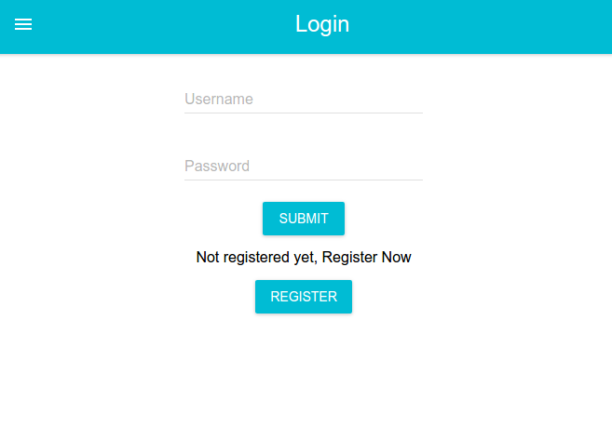

Slide 6
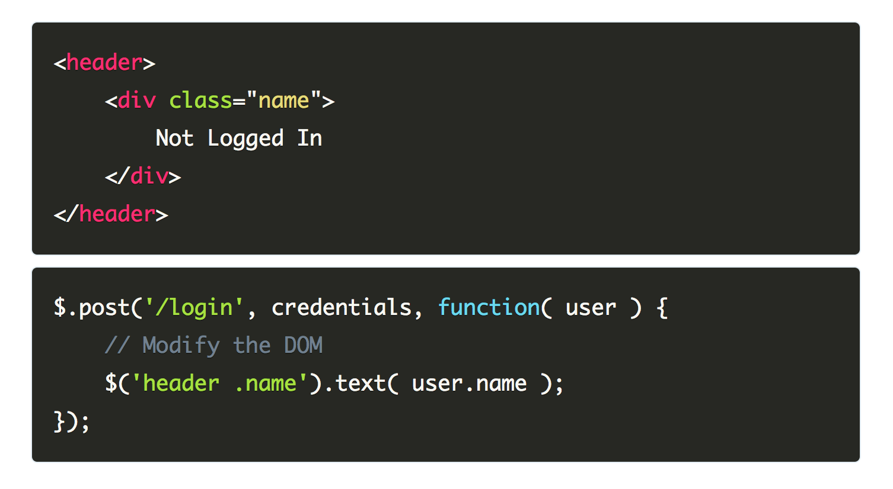

Slide 7
What is React?

Slide 8






Slide 9
What makes React special?
Virtual DOM
ES2016/7
Props
JSX
Components

Slide 10
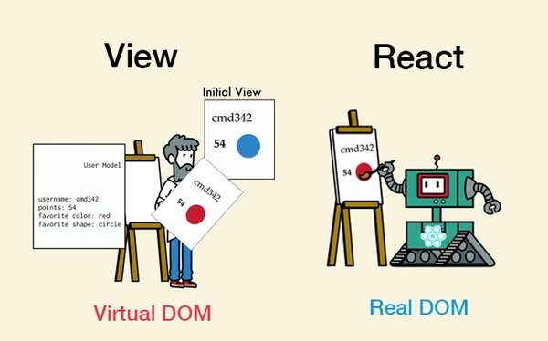
Virtual DOM

Slide 11
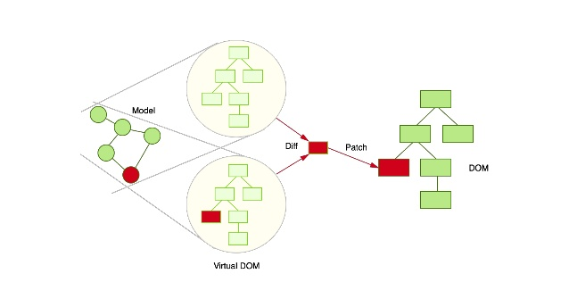

Slide 12
JSX
JavaScript XML

Slide 13
JS...
React.createElement(
'div',
null,
React.createElement('img', { src: url, className: 'avatar' }),
React.createElement(
'span',
{ className: 'full-name' },
fname + lname
)
);

Slide 14
JSX
<div>
<img src={url} className='avatar' />
<span className='full-name'>{fname + lname}</span>
</div>

Slide 15
Components

Slide 17
as JS Functions
function Panel(props) { return (
<div className='panel'>
<img src=‘../assets/pauschtest1.jpg’ />
</div>
); }
const Panel = (props) => (
<div className='panel'>
<img src=‘../assets/pauschtest1.jpg’ />
</div>
);

Slide 18
Nesting Components
function Greet(props) { return <h1>Hello {props.name}</h1>; }
function HelloWorld() {
//React knows <Hello /> is a component because it's capitalized.
return <Greet name="World" />;
}

Slide 19
ES6: Const
const element = <Greet name=”World" />;
Notes:
DOM tags (div) or user defined components)

Slide 20
ES6: Class
class Greet extends React.Component {
render() { return <h1>Hello {this.props.name}</h1>;
} }

Slide 21
ES6: Methods
addNewTheme() {
console.log("This added a new theme");
}

Slide 22
ES6: Constructor
constructor(props) {
super(props);
this.state = {
theme: {
name: "",
totalDuration: 0,
durations: [],
panels: [],
},
};
}

Slide 23
Whole Class
export default class App extends React.Component {
constructor(props) {
super(props);
this.state = {
...
};
}
//Methods
render() {
return (
<div style={appStyle}>
<Header />
<div id='content'></div>
</div>
);
}
}

Slide 24
States

Slide 25
What are states?
this.state = {
theme: {
name: “”,
totalDuration: 0,
durations: [],
panels: [],
},
};

Slide 26
setState
this.setState((prevState, props) => ({ counter: prevState.counter + props.increment }));

Slide 27
More Useful Features

Slide 28
PropTypes
Greeting.propTypes = {
name: PropTypes.string
};

Slide 29
Maps
const numbers = [1, 2, 3, 4, 5];
const listItems = numbers.map((number) =>
<li>{number}</li>
);

Slide 30
Ternary Expressions
borderColor : isSelected ? '#3f51b5' : '#808080'
Notes:
condition ? true : false

Slide 31
Putting It All Together

